Slide 1
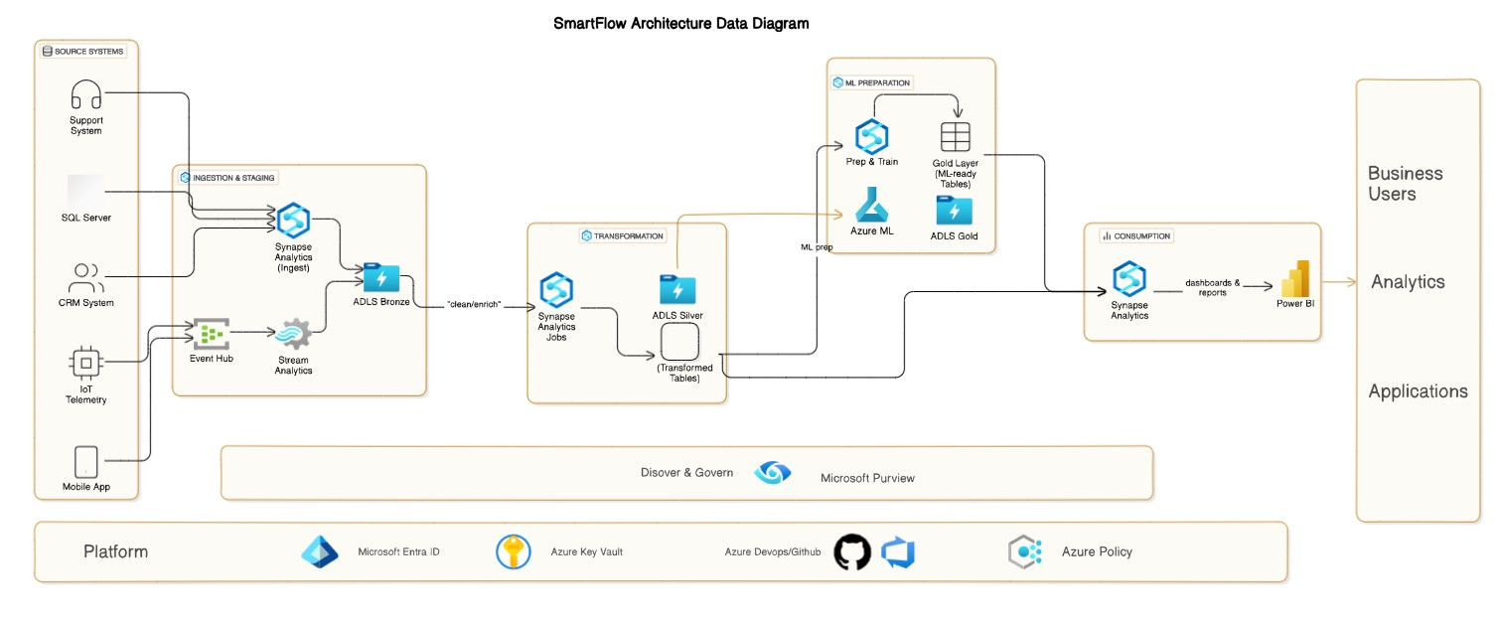
SmartFlow Data Architecture
A Modern Data Platform Overview

Slide 2
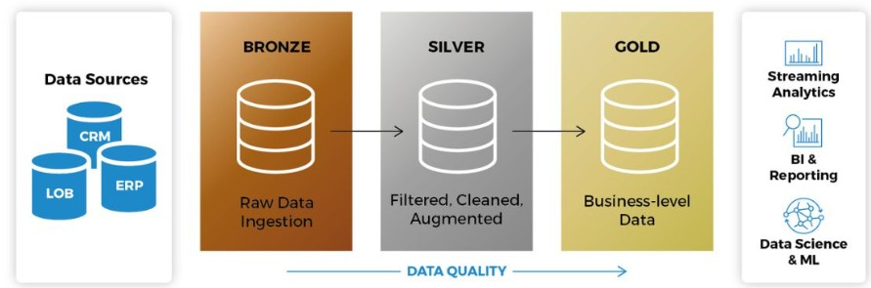
Data Flow & Medallion Architecture
- Ingests from CRM, SQL Server OLTP, IoT, Mobile Apps
- Bronze: Raw landing (batch & streaming)
- Silver: Cleaned, conformed datasets
- Gold: Aggregated for Analytics, Reporting, ML
- Secured with Azure Key Vault, Azure Policy, Purview

Slide 3
Batch Ingestion Path
Source Extraction: Nightly or hourly extracts from SQL Server and CRM via Synapse Analytics pipelines ( i.e Copy Data).
Landing (Bronze): Data is written raw into an Azure Data Lake Storage (ADLS) container in a bronze/ folder, partitioned by ingestion date (YYYY/MM/DD).
Transformation to Silver: Azure Synapse Spark jobs run ELT notebooks to:
Deduplicate and normalize business keys
Parse, type‑cast, and enrich with reference lookups
Write cleaned tables to silver/ folder, partitioned by business date and region
Promotion to Gold: Scheduled Synapse SQL pipelines aggregate and join multiple silver tables into curated gold models.

Slide 4
Streaming Ingestion Path
Event Hub → Stream Analytics: IoT and mobile events stream into Azure Event Hubs. Azure Stream Analytics jobs perform lightweight filtering and windowed aggregations, writing output to Bronze.
Bronze → Silver: Synapse Streaming Spark jobs continuously read bronze folders (or via Azure Synapse pipelines’ Delta Autoloader) to:
Enrich with master data
Apply business rules (e.g., anomaly detection)
Write to silver/telemetry/ as micro‑batch Delta tables
Real‑Time Gold: Low‑latency Synapse SQL on-demand queries produce real‑time views in Gold, backed by materialized views for dashboards.

Slide 5
Medallion Layers Summary
Layer | Purpose | Consumers
Bronze | Raw snapshots | Data Engineers
Silver | Cleaned, enriched datasets | BI Developers, Data Scientists
Gold | Curated analytics-ready datasets | Power BI, ML Models, APIs

Slide 6
Data Modeling Overview
- Silver Tables: Customer_Events, Transaction_Facts, Device_Telemetry
- Gold Views: Customer360_View, Daily_Revenue, AnomalyAlerts_View
- Partitioning and Z-order optimizations applied

Slide 7
Data Governance Approach
- Quality Checks: Delta Expectations, Data Flow Assertions
- Lineage: Microsoft Purview
- Security: PII classification, RBAC
- Monitoring: Azure Monitor, Log Analytics

Slide 8
ML/AI Data Serving Strategy
- Feature generation from Silver to Gold
- Feature Store (Azure ML)
- Offline (Delta) & Online (Cosmos DB/Redis) features
- Training pipelines, real-time inference with Azure Functions / AKS

Slide 9
Structured and Unstructured Integration
- Structured: Silver → Gold → Feature Store
- Unstructured: Embeddings via Databricks MLFlow
- Unified model training and serving

Slide 10
Closing
SmartFlow delivers a scalable, secure, high-quality data platform powering analytics and AI across batch, streaming, structured, and unstructured data!

